Slide 1
Race To a Dollar Game
By Kush Patel

Slide 2
Purpose of the Game
Teach kids how to count coins and make exactly $1 or whatever the goal amount is which you can change in the code.
Help kids understand money value through a fun game.

Slide 3
How to Play
Two players (Human vs AI).
Pick coins without exceeding $1.
Only valid coins can be picked.
First to reach exactly $1 wins!

Slide 4
Game Rules
You can only pick valid coins based on current amount.
Must reach exactly the target amount depending on that the target amount is — no more, no less.
The target amount can be $1.00 or $1.24
The Human Player must go first because if the AI player goes first then he’ll always win due to him strategizing his move as the best move

Slide 5
AI and Algorithms
AI uses Alpha-Beta Pruning algorithm.
AI makes strategic choices, not random.
I modified the algorithm slightly:
Added depth limit.
Sorted actions for smarter moves.
Without the depth limit the AI would continue searching in some cases if all moves are equally good

Slide 6
Programming Details
Language: Python
Libraries: NumPy, Tkinter (for GUI)
No external datasets needed.

Slide 7
GUI Features
Tkinter-based interface.
Displays current amount and coin list.
Shows whose turn it is (Human or AI).
Updates game state after every move

Slide 8
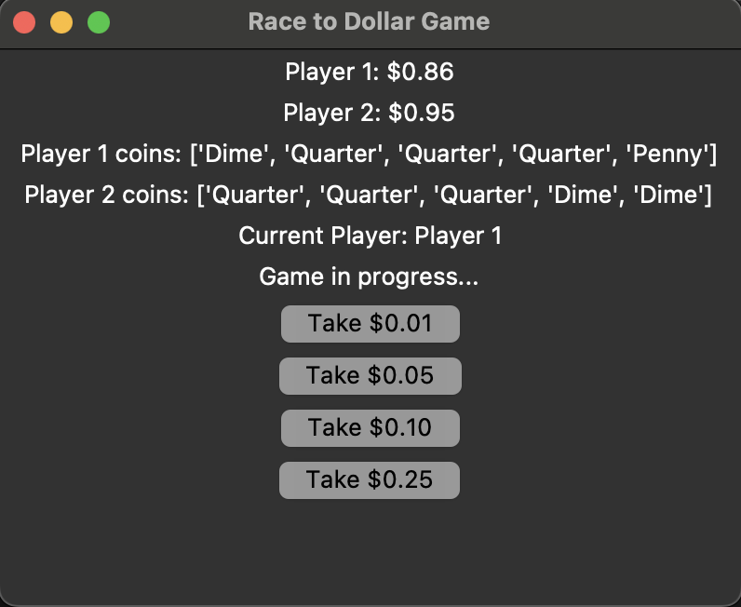
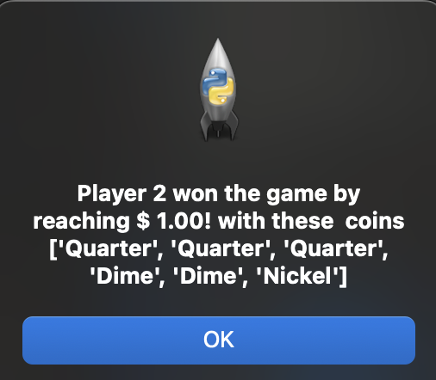
Game GUI

Slide 9
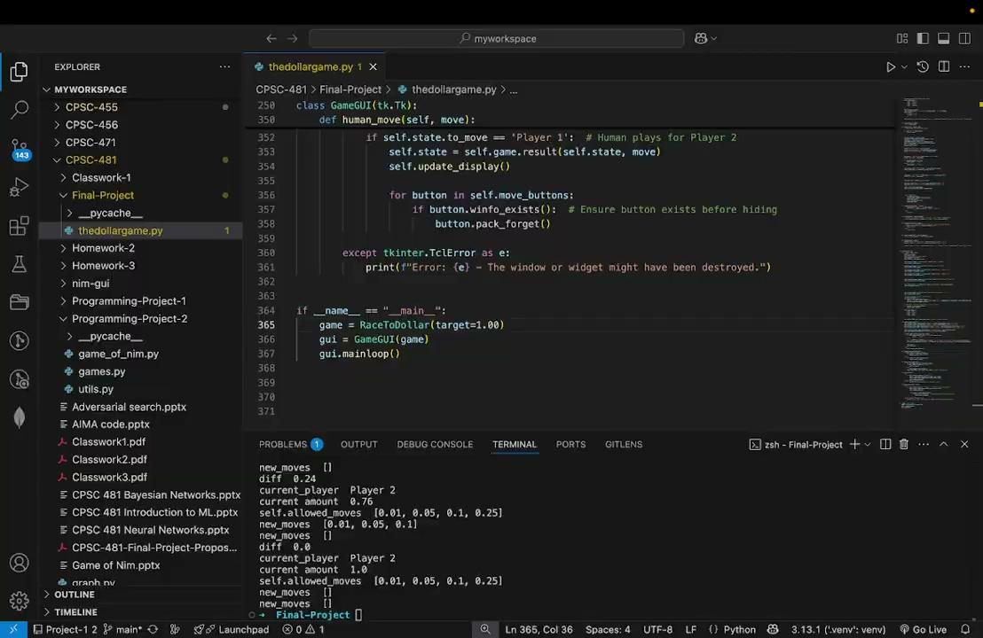
Game Demo 1

Slide 10
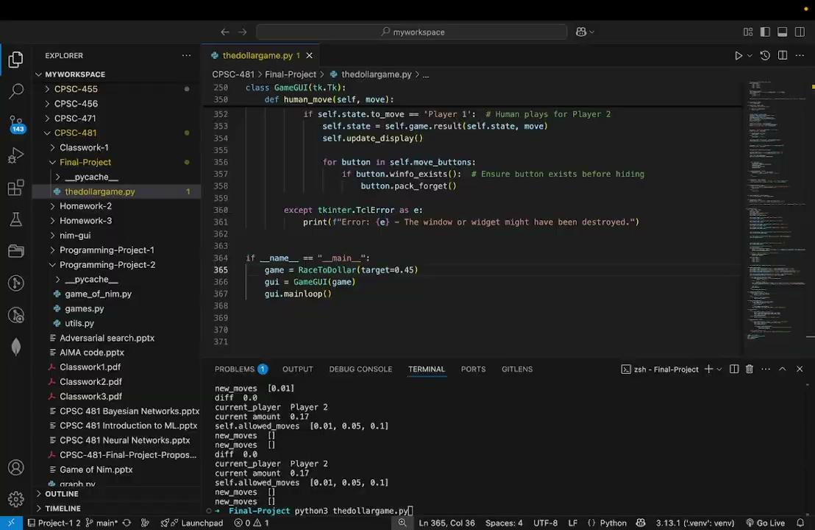
Game Demo 2

Slide 11
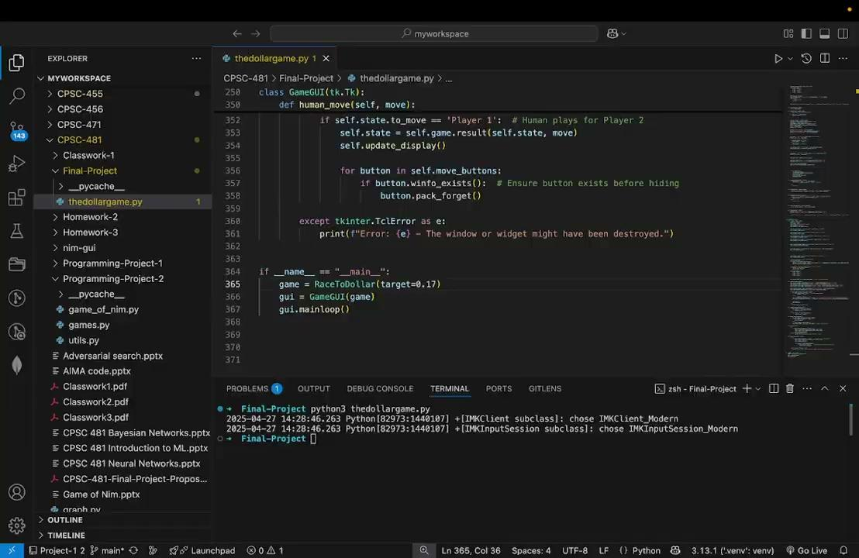
Game Demo 3

Slide 12
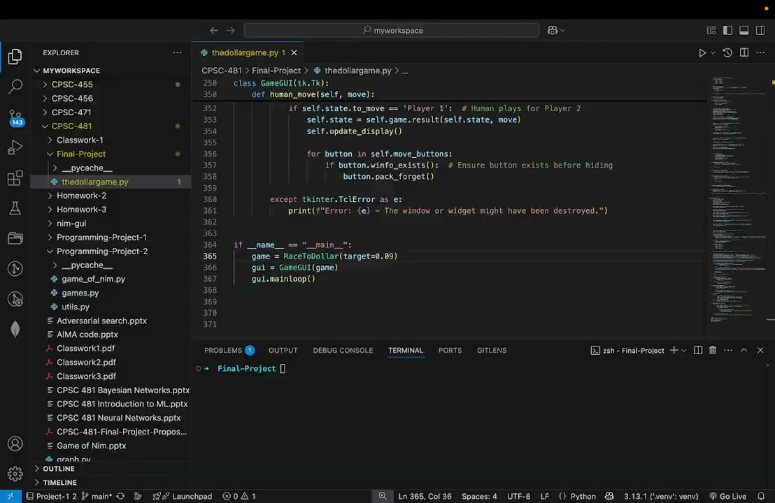
Game Demo 4

